Slide 1


JAVA PERSISTENCE API
Part 1 – Entity management
YURIY OGLABYAK
SEPTEMBER 13, 2016

Slide 2

AGENDA
1
Purpose, evolution history, implementations
2
Object-relational mapping
3
Validation
5
Persistence context (overview)
6
Configuration

Slide 3
GOALS
Model bean class/instances ~ database table/rows
Bean fields/properties ~ table columns/cells
Bean relations ~ foreign keys, intermediate tables
DECLARATIVE OBJECT-RELATIONAL MAPPING
1
Java standard API specification
Adapting RDBMS from different vendors
High-level CRUD operations wrapping JDBC
High-level search (query language vs. query builder API)
UNIFIED
PERSISTENCE
APPROACH
2
Transaction management
Locking & versioning
Multi-level caching
Performance optimizations (lazy load, cascading, batches) etc.
3
ENTERPRISE
FEATURES

Slide 4
HISTORY
Dec 1999- Aug 2001
EJB 1.1 CMP
EJB 2.0 CMP (JSR 19)
Jul 2002 – Mar 2005
Hibernate 1.0
Hibernate 2.0
Hibernate 3.0 @
May 2006 – Oct 2006
JPA 1.0 @ (JSR 220)
Hibernate 3.2 (JPA 1.0)
Dec 2009 – Dec 2011
JPA 2.0 (JSR 317)
Hibernate 3.5 (JPA 2.0)
Hibernate 4.0
Apr 2013 – Sep 2015
JPA 2.1
Hibernate 4.3 (JPA 2.1)
Hibernate 5.0 λ

Slide 5





POPULAR IMPLEMENTATIONS

Slide 6
ORM PARADIGM MISMATCH
GRANULARITY
One table can map into several classes or vice-versa
SUBTYPING
RDBMS has no standard inheritance support
EQUALITY
DB tables use primary keys while Java has reference equality (==) and customizable equality check method (.equals)
ASSOCIATONS
DB table dependencies are unidirectional one-to-many by nature
DATA NAVIGATION
Java (OOP) allows browsing object structures though associations network; which is too expensive in RDBMS

Slide 7
JPA ORM
1
Entity bean requirements
2
Class-level mapping, inheritance
3
Field-level mapping
6
Identifiers, value generation
4
Relations
5
Definition overrides

Slide 8
ENTITY REQUIREMENTS
POJO
Must have public or protected no-argument constructor
Class must not be declared final
No methods or persistent fields must be declared final
Persistent fields should not be declared public and should be accessed directly only by the entity class’s methods

Slide 9
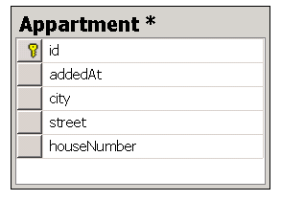
EXAMPLE – SIMPLE ENTITY
import java.util.Date;
import javax.persistence.Entity;
import javax.persistence.Id;
@Entity
public class Appartment {
@Id
private Long id;
private Date addedAt;
private String city;
private String street;
private String houseNumber;
}
Notes:
P37 – divide into 2 slides

Slide 10
EXAMPLE – SIMPLE ENTITY
import java.util.Date;
import javax.persistence.Column;
import javax.persistence.Entity;
import javax.persistence.Id;
import javax.persistence.Table;
@Entity
@Table(name = "Appartment", schema = "dbo")
public class Appartment {
@Id
@Column(name = "id", updatable = false, insertable = true)
private Long id;
@Column(name = "addedAt", nullable = false)
private Date addedAt;
private String city;
private String street;
@Column(name = "houseNumber", length = 20)
private String houseNumber;
}
Notes:
P37 – divide into 2 slides

Slide 11
ONE TABLE ~ SEVERAL CLASSES
1
Embed set of fields
2
Inherit from non-entity superclass
2
Inherit from entity superclass

Slide 12
EXAMPLE – AGGREGATE SET OF FIELDS
import java.util.Date;
import javax.persistence.Embeddable;
import javax.persistence.Embedded;
import javax.persistence.Entity;
import javax.persistence.Id;
@Entity
public class Appartment {
@Id
private Long id;
private Date addedAt;
@Embedded
private Address address;
}
@Embeddable
public class Address {
private String city;
private String street;
private String houseNumber;
}
Notes:
P37 – divide into 2 slides

Slide 13
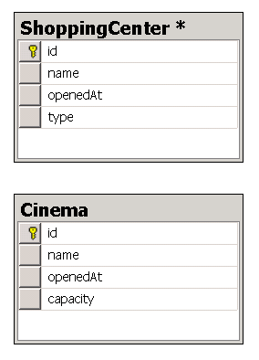
EXAMPLE – INHERIT SET OF FIELDS
@MappedSuperclass
public class Building {
@Id
private Long id;
private String name;
private Date openedAt;
}
@Entity
public class ShoppingCenter extends Building {
private String type;
}
@Entity
public class Cinema extends Building {
private int capacity;
}
Notes:
P37 – divide into 2 slides

Slide 14
EXAMPLE – INHERIT SET OF FIELDS
@Entity
public abstract class Building {
@Id
private Long id;
private String name;
private Date openedAt;
}
@Entity
public class ShoppingCenter extends Building {
private String type;
}
@Entity
public class Cinema extends Building {
private int capacity;
}
Notes:
P37 – divide into 2 slides

Slide 15
SEVERAL TABLES ~ ONE CLASS
1
Declare secondary table

Slide 16
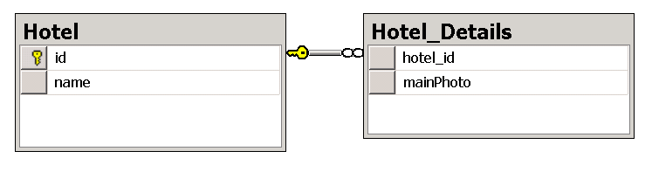
EXAMPLE – SPLIT INTO FEW TABLES
@Entity
@Table(name = "Hotel")
@SecondaryTable(name = "Hotel_Details",
pkJoinColumns = @PrimaryKeyJoinColumn(name = "hotel_id"))
public class Hotel {
@Id
private Long id;
private String name;
@Column(name = "mainPhoto", table = "Hotel_Details")
private byte[] mainPhoto;
}
Notes:
P37 – divide into 2 slides

Slide 17
ENTITY INHERITANCE STRATEGIES
1
Single table per hierarchy
2
Table per concrete class
2
Joined subclass

Slide 18
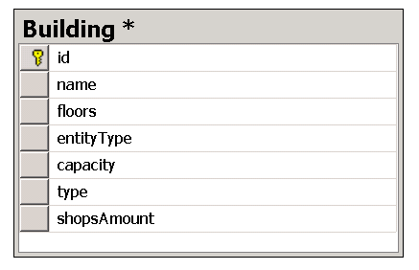
EXAMPLE – SINGLE TABLE INHERITANCE
@Entity
@Inheritance(strategy = InheritanceType.SINGLE_TABLE)
@DiscriminatorColumn(name = "entityType")
@DiscriminatorValue("B")
public class Building {
@Id
private Long id;
private String name;
private int floors;
}
@Entity
@DiscriminatorValue("C")
public class Cinema extends Building {
private int capacity;
}
@Entity
@DiscriminatorValue("S")
public class ShoppingCenter extends Building {
private String type;
private int shopsAmount;
}
Notes:
P37 – divide into 2 slides

Slide 19
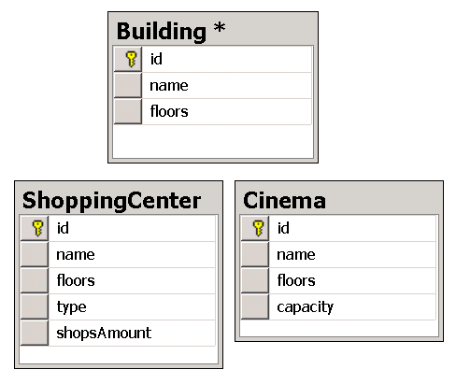
EXAMPLE – TABLE PER CLASS INHERITANCE
@Entity
@Inheritance(strategy = InheritanceType.TABLE_PER_CLASS)
public class Building {
@Id
private Long id;
private String name;
private int floors;
}
@Entity
class Cinema extends Building {
private int capacity;
}
@Entity
class ShoppingCenter extends Building {
private String type;
private int shopsAmount;
}
Notes:
P37 – divide into 2 slides

Slide 20
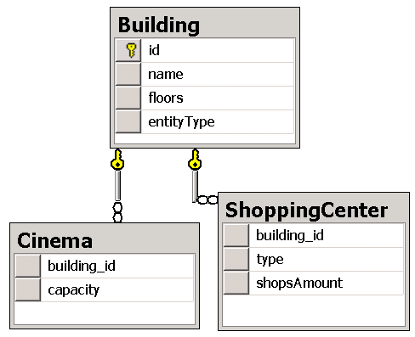
EXAMPLE – JOINED SUBCLASS INHERITANCE
@Entity
@Inheritance(strategy = InheritanceType.JOINED)
@DiscriminatorColumn(name = "entityType")
@DiscriminatorValue("B")
public class Building {
@Id
private Long id;
private String name;
private int floors;
}
@Entity
@DiscriminatorValue("C")
@PrimaryKeyJoinColumn(name = "building_id")
class Cinema extends Building {
private int capacity;
}
@Entity
@DiscriminatorValue("S")
@PrimaryKeyJoinColumn(name = "building_id")
class ShoppingCenter extends Building {
private String type;
private int shopsAmount;
}
Notes:
P37 – divide into 2 slides

Slide 21
FIELD TYPES
1
Primitives, primitive wrappers, String
2
Date and time
2
Enumerations
2
Collections of elements
2
Large binary or character arrays
2
Serializable
2
Any other types over Attribute Converters

Slide 22
SOURCE – FIELD MAPPING ANNOTATIONS
@Target({ElementType.METHOD, ElementType.FIELD})
@Retention(RetentionPolicy.RUNTIME)
public @interface Column {
String name() default "";
boolean unique() default false;
boolean nullable() default true;
boolean insertable() default true;
boolean updatable() default true;
String columnDefinition() default "";
String table() default "";
int length() default 255;
int precision() default 0;
int scale() default 0;
}
@Target({ElementType.METHOD, ElementType.FIELD})
@Retention(RetentionPolicy.RUNTIME)
public @interface Basic {
FetchType fetch() default FetchType.EAGER;
boolean optional() default true;
}
Notes:
P37 – divide into 2 slides

Slide 23
EXAMPLE – FIELD MAPPING (PRIMITIVES)
@Entity
public class RealEstateAgency {
@Id
@Column(name = "agency_id")
private Long id;
@Column(name = "name", length = 250)
private String name;
@Column(name = "unifiedCode", unique = true, nullable = false)
private int unifiedCode;
@Column(name = "revenue", precision = 17, scale = 2)
private Double revenue;
…
}
Notes:
P37 – divide into 2 slides

Slide 24
EXAMPLE – FIELD MAPPING (DATES, ENUMS)
@Entity
public class RealEstateAgency {
…
@Column(name="foundedAt")
@Temporal(TemporalType.DATE)
private Date foundationDate;
@Temporal(TemporalType.TIMESTAMP)
private Calendar lastModifiedAt;
@Column(name="region")
@Enumerated(EnumType.ORDINAL)
private Region regionalLocation;
@Enumerated(EnumType.STRING)
private AgencyType type;
@Lob
@Basic(fetch=FetchType.LAZY)
private byte[] photo;
@Lob
private String resume;
}
Notes:
P37 – divide into 2 slides

Slide 25
EXAMPLE – FIELD MAPPING (COLLECTION)
@Entity
public class RealEstateAgency {
…
@ElementCollection
@Column(name = "phone_number")
@CollectionTable(
name = "agency_phones",
joinColumns = @JoinColumn(name = "agency_id"))
private List<String> phones;
}
Notes:
P37 – divide into 2 slides

Slide 26
EXAMPLE – MAPPING CONTROL
@Entity
@Access(AccessType.FIELD)
public class RealEstateAgency {
…
@Transient
private String openPassword;
private String description;
@Access(AccessType.PROPERTY)
public String getDescription() {
return description;
}
public void setDescription(String description) {
this.description = description;
}
}
Notes:
P37 – divide into 2 slides

Slide 27
EXAMPLE – MAPPING CUSTOMIZATION
@Entity
public class RealEstateAgency {
…
@Column(name = "createdAt")
@Convert(converter = ZonedDateTimeConverter.class)
private ZonedDateTime creationDate;
}
@Converter(autoApply = true)
public class ZonedDateTimeConverter implements AttributeConverter<ZonedDateTime, Date> {
public Date convertToDatabaseColumn(ZonedDateTime toConvert) {
return toConvert == null ? null : Date.from(toConvert.toInstant());
}
public ZonedDateTime convertToEntityAttribute(Date toConvert) {
return toConvert == null ? null : ZonedDateTime.from(toConvert
.toInstant());
}
}
Notes:
P37 – divide into 2 slides

Slide 28
JPA ORM
1
Entity bean requirements
2
Class-level mapping, inheritance
3
Field-level mapping (we were here)
6
Identifiers, value generation
4
Relations
5
Definition overrides

Slide 29
ENTITY IDENTITIES
1
Simple @Id
2
Composite @EmbeddedId
2
Composite @IdClass

Slide 30
EXAMPLE – EMBEDDED IDENTITY
@Entity
public class Appartment {
@EmbeddedId
private AppartmentId id;
private Double price;
}
@Embeddable
public class AppartmentId implements Serializable {
private String address;
private Integer roomNumber;
public int hashCode() {...}
public boolean equals(Object obj) {...}
}
Notes:
P37 – divide into 2 slides

Slide 31
EXAMPLE – CLASS IDENTITY
@IdClass(AppartmentId.class)
@Entity
public class Appartment {
@Id
private String address;
@Id
private Integer roomNumber;
private Double price;
}
public class AppartmentId implements Serializable {
private String address;
private Integer roomNumber;
public int hashCode() {...}
public boolean equals(Object obj) {...}
}
Notes:
P37 – divide into 2 slides

Slide 32
GENERATED VALUE STRATEGIES
1
Table generator
2
Sequence
2
Identity
2
Auto-selection

Slide 33
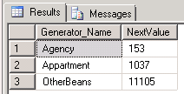
EXAMPLE – VALUE GENERATION
@Id
@GeneratedValue(strategy = GenerationType.IDENTITY)
private Long id;
@GeneratedValue(strategy = GenerationType.SEQUENCE, generator = "AgencySeq")
@SequenceGenerator(
name = "AgencySeq",
sequenceName = "AgencyRegNumber_Seq",
initialValue = 1,
allocationSize = 100)
private Integer sequenceNumber;
@TableGenerator(
name = "AgencyTbl",
table = "TableGenerators",
pkColumnName = "Generator_Name",
pkColumnValue = "Agency",
valueColumnName = "NextValue",
initialValue = 0,
allocationSize = 100)
@GeneratedValue(strategy = GenerationType.TABLE, generator = "AgencyTbl")
private Integer registrationNumber;
Notes:
P37 – divide into 2 slides

Slide 34
RELATIONS
1
One-to-One
1
Unidirectional
2
One-to-Many
2
Bidirectional
2
Many-to-One
2
Many-to-Many

Slide 35
EXAMPLE – ONE-TO-ONE
@Entity
public class Hotel {
@Id
private Long id;
private String name;
@OneToOne(fetch = FetchType.LAZY)
@JoinColumn(name = "details_id")
private HotelDetails details;
}
@Entity
public class HotelDetails {
@Id
private Long details_id;
public byte[] mainPhoto;
public String city;
@OneToOne(mappedBy="details")
private Hotel hotel;
}
Notes:
P37 – divide into 2 slides

Slide 36
EXAMPLE – ONE-TO-MANY / MANY-TO-ONE
@Entity
public class Hotel {
@Id
private Long id;
private String name;
@OneToMany(targetEntity = Appartments.class, mappedBy = "hotel")
private Collection<Appartments> details;
}
@Entity
class Appartments {
@Id
private Long id;
private Integer number;
private Double price;
@ManyToOne
@JoinColumn(name = "hotel_id")
private Hotel hotel;
}
Notes:
P37 – divide into 2 slides

Slide 37
EXAMPLE – ONE-TO-MANY as collection
@Entity
public class Hotel {
@Id
private Long id;
private String name;
@ElementCollection(targetClass = Reward.class)
@CollectionTable(
name = "HotelRewards",
joinColumns = {@JoinColumn(name="hotel_id")})
@MapKeyColumn(name="rewardCode")
private Map<String, Reward> rewards = new HashMap<String, Reward>();
}
@Embeddable
class Reward {
private String rewardCode;
private String rewardName;
private Date rewardDate;
}
Notes:
P37 – divide into 2 slides

Slide 38
EXAMPLE – MANY-TO-MANY
@Entity public class Appartments {
@Id private Long id;
private Integer number;
private Double price;
@ManyToMany
@JoinTable(
name = "AppartmentVisitors",
joinColumns = @JoinColumn(name = "appartment_id"),
inverseJoinColumns = @JoinColumn(name = "visitor_id"))
private Collection<Visitor> visitors = new HashSet<Visitor>();
public void addVisitor(Visitor visitor) {
getVisitors().add(visitor);
visitor.getAppartments().add(this);
}
}
@Entity public class Visitor {
@Id private Long id;
private String name;
@ManyToMany(mappedBy = "visitors", targetEntity = Appartments.class)
private Collection<Appartments> appartments;
}
Notes:
P37 – divide into 2 slides

Slide 39
DEFINITION OVERRIDES
1
Attribute override
2
Association override

Slide 40
EXAMPLE – DEFINITION OVERRIDES
@Embeddable
public class Address {
@Column(name = "city")
private String city;
private String street;
private String houseNo;
}
@Entity
public class Theatre {
@Id
private int id;
private String name;
@Embedded
@AttributeOverrides({
@AttributeOverride(name = "city", column = @Column(name = "town")),
@AttributeOverride(name = "houseNo", column = @Column(name = "buildingNo"))})
private Address address;
}
Notes:
P37 – divide into 2 slides

Slide 41
JPA ORM
1
Entity bean requirements
2
Class-level mapping, inheritance
3
Field-level mapping
6
Identifiers, value generation
4
Relations
5
Definition overrides (we were here)

Slide 42
BEAN VALIDATION (JSR 303)
@Entity
public class Agent {
@Id
private Long id;
@NotNull
protected String name;
@Pattern(regexp = "[0-9]{10}")
protected String cellPhone;
@Temporal(TemporalType.DATE)
@Past
protected Date birthday;
@NotNull
@Valid
@OneToOne
@JoinColumn(name = "address_id")
protected Addresss address;
}
@Entity
public class Addresss {
@Id
private Long id;
private String city;
private String street;
private String houseNumber;
}

Slide 43
PERSISTENCE CONTEXT
1
Entity manager & entity manager factory
2
Entity lifecycle
2
Cascading
3
Entity listeners and callback methods
6
Caching
6
Version control
6
Transactions support (CMT & BMT)

Slide 44
Configuration: persistence.xml
<persistence xmlns="http://java.sun.com/xml/ns/persistence" xmlns:xsi="http://www.w3.org/2001/XMLSchema-instance" xsi:schemaLocation="http://java.sun.com/xml/ns/persistence http://java.sun.com/xml/ns/persistence/persistence" version="1.0"> <persistence-unit name="JPAService" transaction-type="RESOURCE_LOCAL"> <properties> <property name="hibernate.dialect" value="org.hibernate.dialect.HSQLDialect"/> <property name="hibernate.hbm2ddl.auto" value="update"/> <property name="hibernate.connection.driver_class" value="org.hsqldb.jdbcDriver"/> <property name="hibernate.connection.username" value="sa"/> <property name="hibernate.connection.password" value=""/> <property name="hibernate.connection.url" value="jdbc:hsqldb:data/tutorial"/> </properties> </persistence-unit> </persistence>

Slide 45
ENTITY MANAGERS
1
Application managed
2
Container managed

Slide 46
CONTAINER-MANAGED CONTEXT
@Repository
public class AppartmentService {
@PersistenceContext
private EntityManager em;
public void doMethod() {
em.persist(new Hotel());
}
}

Slide 47
APPLICATION-MANAGED CONTEXT
@Repository
public class AppartmentService {
@PersistenceUnit
EntityManagerFactory emf;
@Resource
UserTransaction utx;
public void doMethod() {
EntityManager em = emf.createEntityManager();
try {
utx.begin();
em.persist(new Hotel());
utx.commit();
} catch (Exception e) {
utx.rollback();
}
}
}

Slide 48
SOURCE – ENTITY MANAGER
public abstract interface EntityManager {
public abstract void persist(Object paramObject);
public abstract <T> T merge(T paramT);
public abstract void remove(Object paramObject);
public abstract <T> T find(Class<T> paramClass, Object paramObject);
public abstract void flush();
public abstract void setFlushMode(FlushModeType paramFlushModeType);
public abstract void lock(Object paramObject, LockModeType type);
public abstract void refresh(Object paramObject);
public abstract void clear();
public abstract void detach(Object paramObject);
public abstract Query createQuery(String paramString);
public abstract <T> TypedQuery<T> createQuery(CriteriaQuery<T> query);
public abstract void joinTransaction();
public abstract Object getDelegate();
public abstract void close();
public abstract EntityTransaction getTransaction();
public abstract CriteriaBuilder getCriteriaBuilder();
public abstract Metamodel getMetamodel();
…}

Slide 49
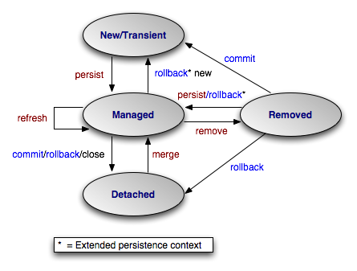
ENTITY LIFECYCLE

Slide 50
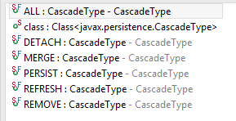
EXAMPLE - CASCADING
@Entity
public class Hotel {
@Id
private Long id;
private String name;
@OneToMany(cascade = CascadeType.ALL, mappedBy = "hotel")
@JoinColumn(referenceColumnName = "hotel_id")
private Collection<Appartments> details;
}
@Entity
class Appartments {
@Id
private Long id;
private Integer number;
private Double price;
}

Slide 51
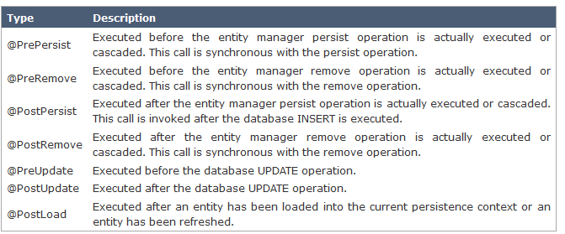
CALLBACK METHODS

Slide 52
EXAMPLE – CALLBACK METHOD & LISTENER
@Entity
@ExcludeSuperclassListeners
@EntityListeners(LogListener.class)
public class Agent extends Person {
@Id
private Long id;
protected String name;
@PrePersist
@PreUpdate
public void trimStrings() {
name = (name == null ? null : name.trim());
}
}
class LogListener {
@PostLoad
public void objectLoaded(Object obj) {
System.out.println("Loaded from DB " + obj);
}
}

Slide 53
MORE INFORMATION
http://hibernate.org/orm/what-is-an-orm/ (ORM)
http://docs.oracle.com/javaee/6/tutorial/doc/bnbpy.html (Oracle tutorial)
http://www.thoughts-on-java.org/jpa-21-overview/ (JPA 2.1 new)
http://www.java2s.com/Code/Java/JPA/CatalogJPA.htm (code examples)
Not covered by Lecture:
http://www.baeldung.com/2011/12/13/the-persistence-layer-with-spring-3-1-and-jpa/ (JPA vs Spring config)
https://en.wikibooks.org/wiki/Java_Persistence/Caching (Caching)
http://docs.oracle.com/javaee/6/tutorial/doc/gkjjj.html#gkjeb (Caching)
https://en.wikibooks.org/wiki/Java_Persistence/Locking (Locking and versioning)
https://en.wikibooks.org/wiki/Java_Persistence/Transactions (Transactions: programmatic support)
http://www.kumaranuj.com/2013/06/jpa-2-entitymanagers-transactions-and.html
http://www.datanucleus.org/products/datanucleus/jpa/transactions.html
Notes:
P37 – divide into 2 slides

Slide 54


THANK YOU

